Slide 1


Traffic Manager

Slide 2



Traffic Manager
DNS based load balancer
It works like a end points.
Traffic manager load balancer the end points with 2 factors.
  Routing methods.
  Health of the end point.
East US
India User
South India

Slide 3



Routing methods
Indian User
Central India
East US
US User
 | Central India | East US
India users | 18ms | 80ms
US users | 80ms | 18ms
Performance
It is like a closest end point. You live in India, so you will be redirecting to India a lot.

Slide 4

10% users
Central India
East US
90% users
Weighted
we establish a weight for each end point.
Based on the weight kept on the end point the traffic will route the respective end point.
 | Central India | East US
Weight | 1 | 9

Slide 5

Indian User
Central India
 | Central India | East US
Indian Users
UAE users
US users
UAE User
US User
East US
Geo graphical
some legal reasons entire universe can be redirected to some region but some users only has to redirect to some region (navy data, army data).
Using this which user what to connect to which VM automatically.

Slide 6

Indian User
Central India
East US
US User
Priority based
good on dr activity. Provide priority based on priority it will go.
Until and unless the first end point is down, traffic manager will not send the traffic to second VM.

Slide 7

10.0.0.4
Indian User
10.0.0.5
Multivalue
here only we can use ipv4. we add ip’s then the routing will go as required.

Slide 8
10.0.0.4
 | Central India | East US
End user subnet | 10.0.0.0/24 | All users
Subnet
East US
All Users
Subnet
all the subnet ip user/resources go to one region and remaining will go to another region.

Slide 9
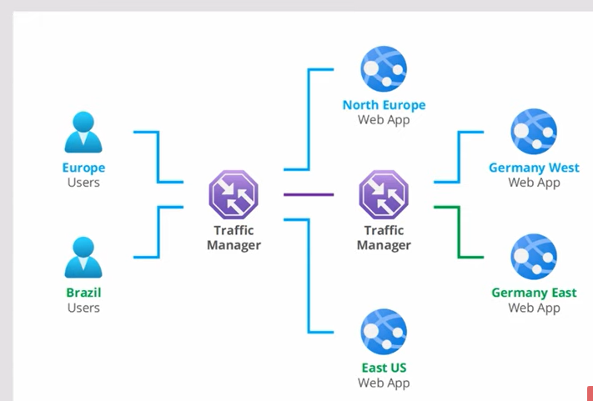
Nested endpoints
Nested endpoints combine multiple Traffic Manager profiles to create flexible traffic-routing schemes to support the needs of larger and complex deployments.
With Nested endpoints, a child profile is added as an endpoint to a parent profile.

Slide 10
Additional information about traffic manager
End point monitoring: traffic manager will monitor all the end point for our backend services.
Traffic views: we can see where our traffic is coming.
Real user management
Metrics and alerts

Slide 11
Demo
Create infra using script
Go scm urls of the app services and update the html pages and check working condition.
Create traffic manager with performance routing option.
Once traffic manager created we can find the dns url from overview page it self. Also we want we can disable the traffic manager for sometime.
Go to end points. →add → create 2 end points one for east us and second for central india. → wait till end points status changed to online.
Then put the dns url in brouser, we will get the central india url.
Then login to servers and check dns url in the server. It should give similar result.
Go back to traffic manager → configuration → change performance to waited → now it should redirect url based on waitage provided.
Geographic:
→Go back to traffic manager → delete the end point due to the end points doesn’t have geographic onfigured.
Go to configuration and change routing method to geographic. → save.
Go back to endpoint → add → now while creating select north America, united state geographic option will be with east us.
Again add endpoint → now regional grouping is central india. → and it should work the same way.

